Slide 1
CHAPTER FOUR
STACKS

Slide 2
stacks
A simple data structure, in which insertion and deletion occur at the same end, is termed (called) a stack. It is a LIFO (Last In First Out) structure.
The operations of insertion and deletion are called PUSH and POP
Push - push (put) item onto stack
Pop - pop (get) item from stack
Initial Stack Push(8) Pop
TOS=>
TOS=> TOS=>
4
8
4
4

Slide 3
stacks
Our Purpose:
To develop a stack implementation that does not tie us to a particular data type or to a particular implementation.
Implementation:
Stacks can be implemented both as an array (contiguous list) and as a linked list.
We want a set of operations that will work with either type of implementation: i.e. the method of implementation is hidden and can be changed without affecting the programs that use them.

Slide 4
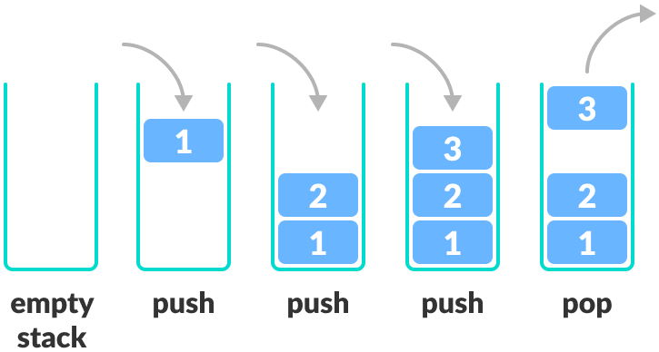
LIFO Principle of Stack
In programming terms, putting an item on top of the stack is called push and removing an item is called pop.
Stack Push and Pop Operations
In the above image, although item 3 was kept last, it was removed first.
This is exactly how the LIFO (Last In First Out) Principle works.

Slide 5
Basic Operations of Stack
There are some basic operations that allow us to perform different actions on a stack.
Push: Add an element to the top of a stack
Pop: Remove an element from the top of a stack
IsEmpty: Check if the stack is empty
IsFull: Check if the stack is full
Peek: Get the value of the top element without removing it

Slide 6
Basic Operations of Stack
Pop()
{
if stack not empty {
return the value of the top item remove the top item from the stack
}
else
{
give an error message
}
}
Push()
{
if there is room {
put an item on the top of the stack
}
else
{
give an error message
}
}

Slide 7
Basic Operations of Stack
CreateStack()
{
remove existing items from the stack
initialise the stack to empty
}

Slide 8
Working of Stack Data Structure
The operations work as follows:
A pointer called TOP is used to keep track of the top element in the stack.
When initializing the stack, we set its value to -1 so that we can check if the stack is empty by comparing TOP == -1.
On pushing an element, we increase the value of TOP and place the new element in the position pointed to by TOP.
On popping an element, we return the element pointed to by TOP and reduce its value.
Before pushing, we check if the stack is already full
Before popping, we check if the stack is already empty

Slide 9
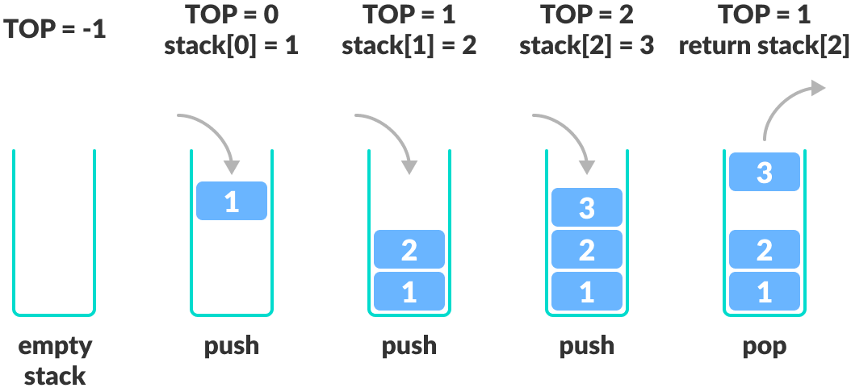
Working of Stack Data Structure

Slide 10
Array Implementation of Stacks: PUSH operation
Addition of an element is known as the PUSH operation.
So, if an array is given to you, which is supposed to act as a STACK, that it has to be a STATIC Stack; meaning, data will overflow if you cross the upper limit of the array.
Algorithm:
Step-1:
Increment the Stack TOP by 1.
Check whether it is always less than the Upper Limit of the stack.
If it is less than the Upper Limit go to step-2 else report -"Stack Overflow"
Step-2:
Put the new element at the position pointed by the TOP

Slide 11
Array Implementation of Stacks: PUSH operation
static int stack[UPPERLIMIT];
int top= -1; /*stack is empty*/
..
..
main()
{
..
..
push(item);
..
..
}
push(int item)
{
top = top + 1;
if(top < UPPERLIMIT)
{
stack[top] = item; /*step-1 & 2*/
}
else
{
cout<<"Stack Overflow";
}
}
Note:- In array implementation, we have taken TOP = -1 to signify the empty stack, as this simplifies the implementation.

Slide 12
Array Implementation of Stacks: Pop operation
POP is the synonym for delete when it comes to Stack.
So, if you're taking an array as the stack, remember that you'll return an error message, "Stack underflow", if an attempt is made to Pop an item from an empty Stack.
Algorithm
Step-1:
If the Stack is empty then give the alert "Stack underflow" and quit; or else go to step-2
Step-2:
Hold the value for the element pointed by the TOP
Put a NULL value instead
Decrement the TOP by 1

Slide 13
Array Implementation of Stacks: Pop operation
int pop()
{
int del_val = 0;
if(top == -1) {
cout<<"Stack underflow"; /*step-1*/
} else {
del_val = stack[top]; /*step-2*/
stack[top] = NULL;
top = top -1;
}
return(del_val);
}
static int stack[UPPPERLIMIT];
int top = -1;
..
..
main()
{
..
..
poped_val = pop();
..
..
}

Slide 14
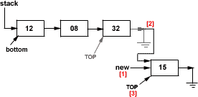
Linked List Implementation of Stacks: PUSH operation
It’s very similar to the insertion operation in a dynamic singly linked list.
The only difference is that here you'll add the new element only at the end of the list, which means addition can happen only from the TOP.
Since a dynamic list is used for the stack, the Stack is also dynamic, means it has no prior upper limit set. So, we don't have to check for the Overflow condition at all!
In Step [1] we create the new element to be pushed to the Stack.
In Step [2] the TOP most element is made to point to our newly created element.
In Step [3] the TOP is moved and made to point to the last element in the stack, which is our newly added element.

Slide 15
Linked List Implementation of Stacks: PUSH operation
Algorithm:
Step-1: If the Stack is empty go to step-2 or else go to step-3
Step-2: Create the new element and make your "stack" and "top" pointers point to it and quit.
Step-3: Create the new element and make the last (top most) element of the stack to point to it
Step-4: Make that new element your TOP most element by making the "top" pointer point to it.

Slide 16
Linked List Implementation of Stacks: PUSH operation
Algorithm:
struct node {
int item;
struct node *next;
}
struct node *stack = NULL; /*stack is initially empty*/
struct node *top = stack;
main()
{
..
..
push(item);
..
}

Slide 17
Linked List Implementation of Stacks: PUSH operation
push(int item)
{
if(stack == NULL) { /*step-1*/
newnode = new node /*step-2*/
newnode -> item = item;
newnode -> next = NULL;
stack = newnode;
top = stack;
} else {
newnode = new node; /*step-3*/
newnode -> item = item;
newnode -> next = NULL;
top ->next = newnode;
top = newnode; /*step-4*/
}
}

Slide 18

Linked List Implementation of Stacks: Pop operation
This is again very similar to the deletion operation in any Linked List, but you can only delete from the end of the list and only one at a time; and that makes it a stack.
Here, we'll have a list pointer, "target", which will be pointing to the last but one element in the List (stack). Every time we POP, the TOP most element will be deleted and "target" will be made as the TOP most element.
In step[1] we got the "target" pointing to the last but one node.
In step[2] we freed the TOP most element.
In step[3] we made the "target" node as our TOP most element.
Supposing you have only one element left in the Stack,
then we won't make use of "target"
rather we'll take help of our "bottom" pointer. See how...

Slide 19
Linked List Implementation of Stacks: Pop operation
Algorithm:
Step-1: If the Stack is empty then give an alert message "Stack Underflow" and quit; or else proceed
Step-2: If there is only one element left go to step-3 or else step-4
Step-3: Free that element and make the "stack", "top" and "bottom" pointers point to NULL and quit
Step-4: Make "target" point to just one element before the TOP; free the TOP most element; make "target" as your TOP most element.

Slide 20
Linked List Implementation of Stacks: Pop operation
struct node {
int nodeval;
struct node *next;
}
struct node *stack = NULL; /*stack is initially empty*/ struct node *top = stack;
main()
{
int newvalue, delval;
..
push(newvalue);
..
delval = pop(); /*POP returns the deleted value from the stack*/
}

Slide 21
Linked List Implementation of Stacks: Pop operation
int pop( )
{
int pop_val = 0;
struct node *target = stack;
if(stack == NULL) /*step-1*/ cout<<"Stack Underflow";
else {
if(top == bottom) { /*step-2*/
pop_val = top -> nodeval; /*step-3*/
delete top;
stack = NULL;
top = bottom = stack;
}
else
{ /*step-4*/
while(target->next != top)
target = target ->next;
pop_val = top->nodeval;
delete top;
top = target;
target ->next = NULL;
}
}
return(pop_val);
}

Slide 22

Applications of Stacks
Evaluation of Algebraic Expressions
e.g. 4 + 5 * 5 simple calculator: 45 scientific calculator: 29 (correct)
Question:
Can we develop a method of evaluating arithmetic expressions without having to ‘look ahead’ or ‘look back’? ie consider the quadratic formula:
x = (-b+(b^2-4*a*c)^0.5)/(2*a)
where ^ is the power operator, or, as you may remember it :
In it’s current form we cannot solve the formula without considering the ordering of the parentheses. i.e. we solve the innermost parenthesis first and then work outwards also considering operator precedence.
Although we do this naturally, consider developing an algorithm to do the same . . . . . . possible but complex and inefficient. Instead . . . .

Slide 23
Applications of Stacks
Re-expressing the Expression
Computers solve arithmetic expressions by restructuring them so the order of each calculation is embedded in the expression.
Once converted an expression can then be solved in one pass.
Types of Expression
The normal (or human) way of expressing mathematical expressions is called infix form,
e.g. 4+5*5. However, there are other ways of representing the same expression, either by writing all operators before their operands or after them,
e.g.: 4 5 5 * +
+ 4 * 5 5
This method is called Polish Notation (because this method was discovered by the Polish mathematician Jan Lukasiewicz).

Slide 24
Applications of Stacks
Re-expressing the Expression
Types of Expression
When the operators are written before their operands, it is called the prefix form
e.g. + 4 * 5 5
When the operators come after their operands, it is called postfix form (suffix form or reverse polish notation)
e.g. 4 5 5 * +

Slide 25
Postfix Evaluation
The valuable aspect of RPN (Reverse Polish Notation or postfix )
Parentheses are unnecessary
Easy for a computer (compiler) to evaluate an arithmetic expression Postfix (Reverse Polish Notation)
Postfix notation arises from the concept of post-order traversal of an expression tree.
Postfix Evaluation
Consider the postfix expression:
6 5 2 3 + 8 * + 3 + *

Slide 26
Postfix Evaluation
initialize stack to empty;
while (not end of postfix expression)
{
get next postfix item;
if(item is value)
push it onto the stack;
else if(item is binary operator) {
pop the stack to x;
pop the stack to y;
perform y operator x;
push the results onto the stack;
}
else if (item is unary operator) {
pop the stack to x;
perform operator(x);
push the results onto the stack
}
}
The single value on the stack is the desired result.
Binary operators: +, -, *, /, etc.,
Unary operators: unary minus, square root, sin, cos, exp, etc.,

Slide 27
Postfix Evaluation
So for 6 5 2 3 + 8 * + 3 + *
the first item is a value (6) so it is pushed onto the stack
the next item is a value (5) so it is pushed onto the stack
the next item is a value (2) so it is pushed onto the stack
the next item is a value (3) so it is pushed onto the stack and the stack becomes
TOS=>
the remaining items are now: + 8 * + 3 + *
So next a '+' is read (a binary operator), so 3 and 2 are popped from the stack and their sum '5' is pushed onto the stack:
3
2
5
6

Slide 28
Postfix Evaluation
TOS=>
Next 8 is pushed and the next item is the operator *:
TOS=>
TOS=>
(8, 5 popped, 40 pushed)
5
5
6
8
5
5
6
40
5
6

Slide 29
Postfix Evaluation
Next the operator + followed by 3:
TOS=>
TOS=>
(40, 5 popped, 45 pushed,3 pushed)
Next is operator +, so 3 and 45 are popped and 45+3=48 is pushed
TOS=>
45
6
3
45
6
48
6

Slide 30
Postfix Evaluation
Next is operator *, so 48 and 6 are popped, and 6*48=288 is pushed
TOS=>
Now there are no more items and there is a single value on the stack, representing the final answer 288.
Note the answer was found with a single traversal of the postfix expression, with the stack being used as a kind of memory storing values that are waiting for their operands.
288

Slide 31
Infix to Postfix (RPN) Conversion
Of course postfix notation is of little use unless there is an easy method to convert standard (infix) expressions to postfix.
Again a simple algorithm exists that uses a stack:
4 : ‘(‘ - only popped if a matching ‘)’ is found 3 : All unary operators
2 : / *
3 : All unary operators
1 : + -
The algorithm immediately passes values (operands) to the postfix expression, but remembers (saves) operators on the stack until their right-hand operands are fully translated.

Slide 32
Infix to Postfix (RPN) Conversion
initialise stack and postfix output to empty;
while(not end of infix expression)
{
get next infix item
if(item is value) append item to pfix o/p
else if(item == ‘(‘) push item onto stack {
else if(item == ‘)’) {
pop stack to x while(x != ‘(‘)
app.x to pfix o/p & pop stack to x
} else {
while(precedence(stack top) >= precedence(item)) pop stack to x & app.x to pfix o/p
push item onto stack
}
}
}
while(stack not empty)
pop stack to x and append x to pfix o/p

Slide 33
Infix to Postfix (RPN) Conversion
eg., consider the infix expression a+b*c+(d*e+f)*g
Stack Output
TOS=> ab
TOS=> abc
TOS=> abc*+
TOS=> abc*+de
TOS=> abc*+de*f
TOS=> abc*+de*f+
*
(
+
+
(
+
*
+
+
+

Slide 34

Infix to Postfix (RPN) Conversion
Stack Output
TOS=> abc*+de*f+g
TOS=> abc*+de*f+g*
Empty abc*+de*f+g*
*
+

Slide 35
Function Calls
When a function is called, arguments (including the return address) have to be passed to the called function.
If these arguments are stored in a fixed memory area then the function cannot be called recursively since the 1st return address would be overwritten by the 2nd return address before the first was used:
10 call function abc(); /* retadrs = 11 */
11 continue;
...
90 function abc;
91 code;
92 if (expression)
93 call function abc(); /* retadrs = 94 */
94 code
95 return /* to retadrs */

Slide 36
Function Calls
A stack allows a new instance of retadrs for each call to the function.
Recursive calls on the function are limited only by the extent of the stack.
10 call function abc(); /* retadrs = 11 */
11 continue;
...
90 function abc;
91 code;
92 if (expression)
93 call function abc(); /* retadrs = 94 */
94 code
95 return /* to retadrs */

Slide 37
Stack Time Complexity
For the array-based implementation of a stack, the push and pop operations take constant time, i.e. O(1).

Slide 38
Applications of Stack Data Structure
Although stack is a simple data structure to implement, it is very powerful. The most common uses of a stack are:
To reverse a word - Put all the letters in a stack and pop them out. Because of the LIFO order of stack, you will get the letters in reverse order.
In compilers - Compilers use the stack to calculate the value of expressions like 2 + 4 / 5 * (7 - 9) by converting the expression to prefix or postfix form.
In browsers - The back button in a browser saves all the URLs you have visited previously in a stack. Each time you visit a new page, it is added on top of the stack. When you press the back button, the current URL is removed from the stack, and the previous URL is accessed.

